Slide 1
Stock Market Analysis
BY GROUP-5
Chitta Ranjan Sahoo
Tharun Vannali
Saket Goud
G Sriram
Kiran Somisetti

Slide 2
Introduction
In this project, we are doing a stock market analysis for the reliance industries stock market dataset where we take datasets from the year 2015 to 2022 data from this data we do data processing, EDA, model building and model deployment and forecast the data for the next 30 days.

Slide 3
Libraries
Pandas | Numpy
Matplotlib | Pyplot
Seaborn | Sklearn
Fbprophet | Statsmodel
Streamlit | yfinance

Slide 4
Data processing and EDA

Slide 5
EDA(Exploratory data Analysis)
Analysis is only based on Open, High, Low, and close price and volume There is no need of Adj Close so we dropped the column.
Convert the date column into datetime value in the yy/mm/dd format and set the column as an index.
Plotted different graphs such as line, box, histogram, and KDE for open price vs date, close price vs date, high price vs date, low price vs date
Plotted a graph for Years vs Volumes
Created two new features for finding long-term and short-term trends using moving averages ( i.e; 30 day moving average and 200 day moving average).
Long-term and short-term trends can be identified using the Moving Average graphs
In the long term, Stock price is in an upward trend
Short-term trends can be identified from the MA-30 chart
Stock had a major short-term downtrend during the year 2020
It may be due to the bearish market during the Covid-19 outbreak

Slide 6
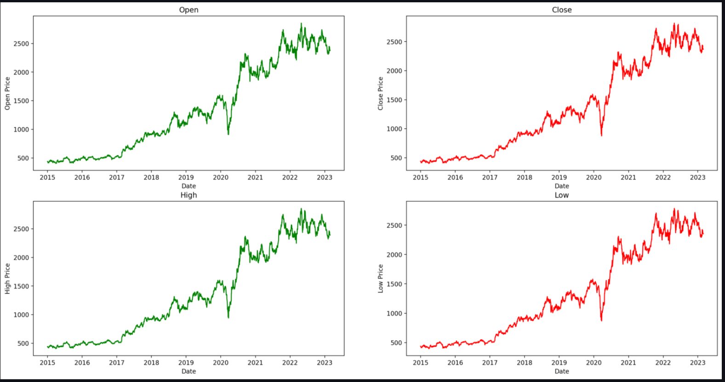
Visualisations
Line Graphs

Slide 7
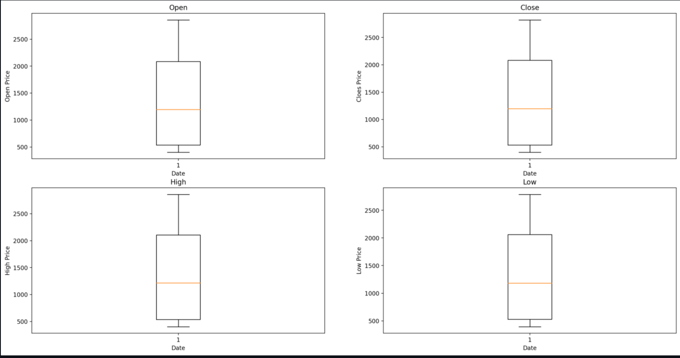
Visualisations
Box plots

Slide 8
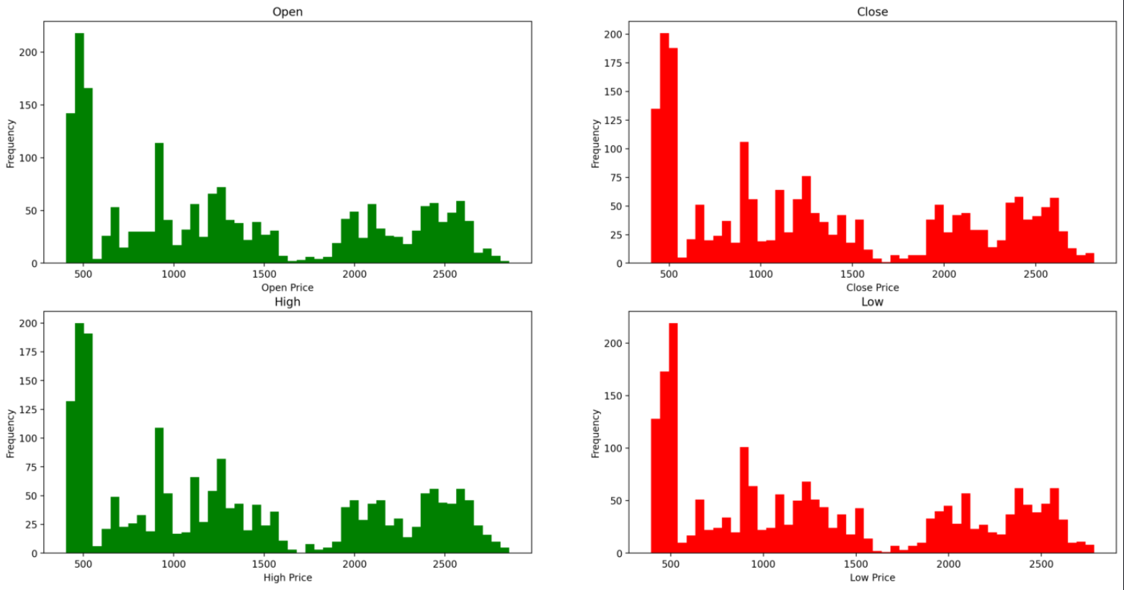
Visualisations
Histograms

Slide 9
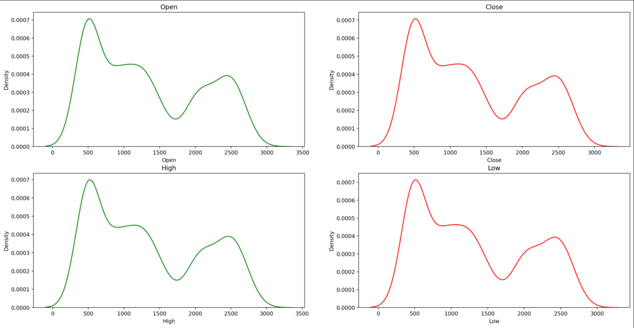
Visualisations
KDE plots

Slide 10
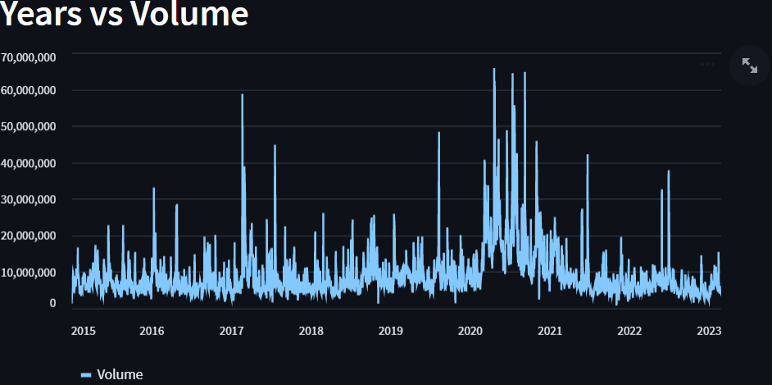
Visualisations
Years vs volume graph

Slide 11
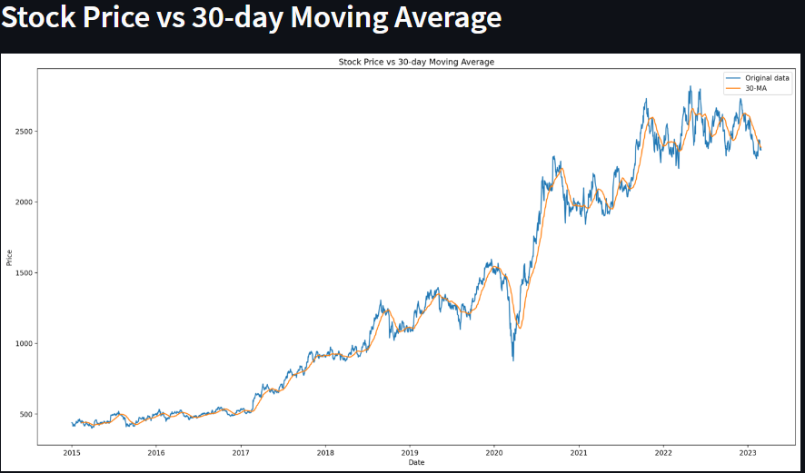
Visualisations
Stock price vs 30-day moving average

Slide 12
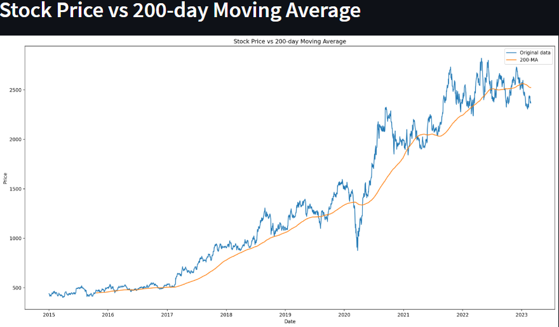
Visualisations
Stock price vs 200-day moving average

Slide 13
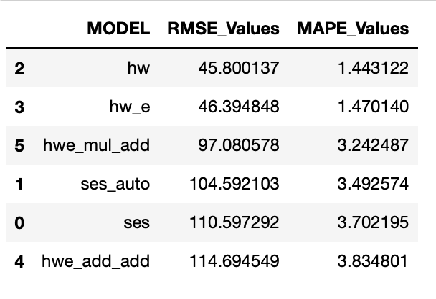
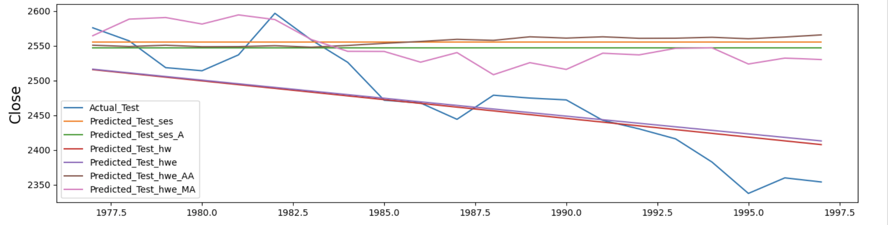
Model building
We built different models such as SES , Holt’s , Holt’s Winter , Holt’s Winter Exponential and Fbprophet.
We trained the models and found out the rmse and mape for every model and compared them with each other as shown in the above image.
Even Though we have good RMSE for HW and HW_e those models are not suitable for data with trend and Seasonality so we prefer holt’s winter exponential with multiplicative seasonality and additive trend as we can see in the graph it is following the test data trend
Other than the these Data-Driven-Based Models we used FBPROPHET model.
So we used it for Deployment.

Slide 14
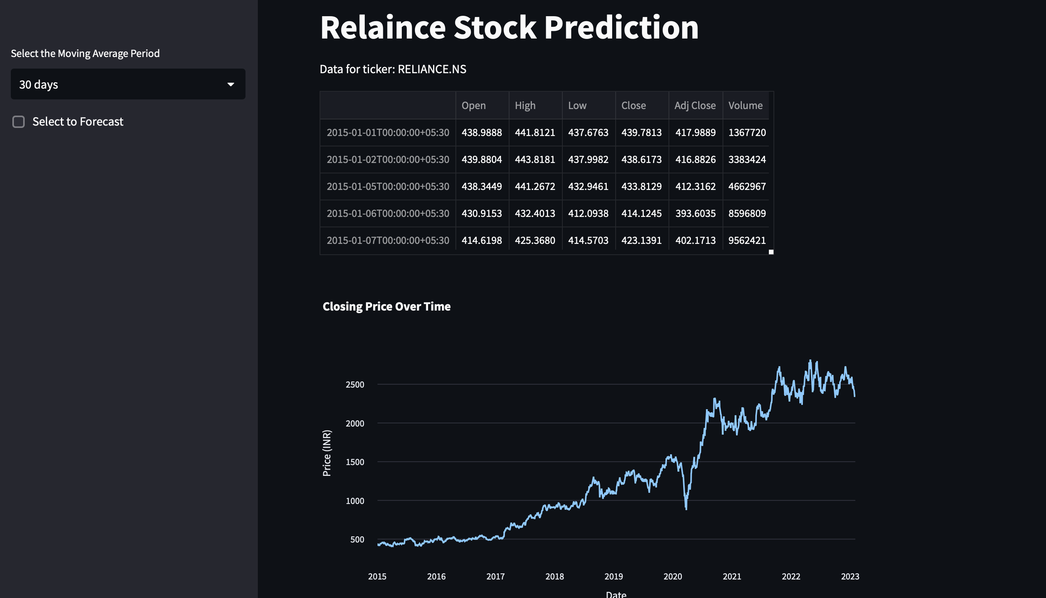
Model Deployment

Slide 15
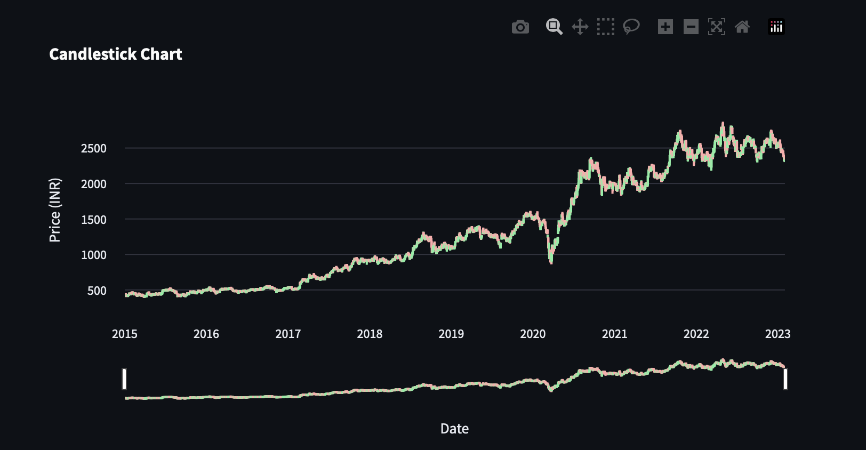
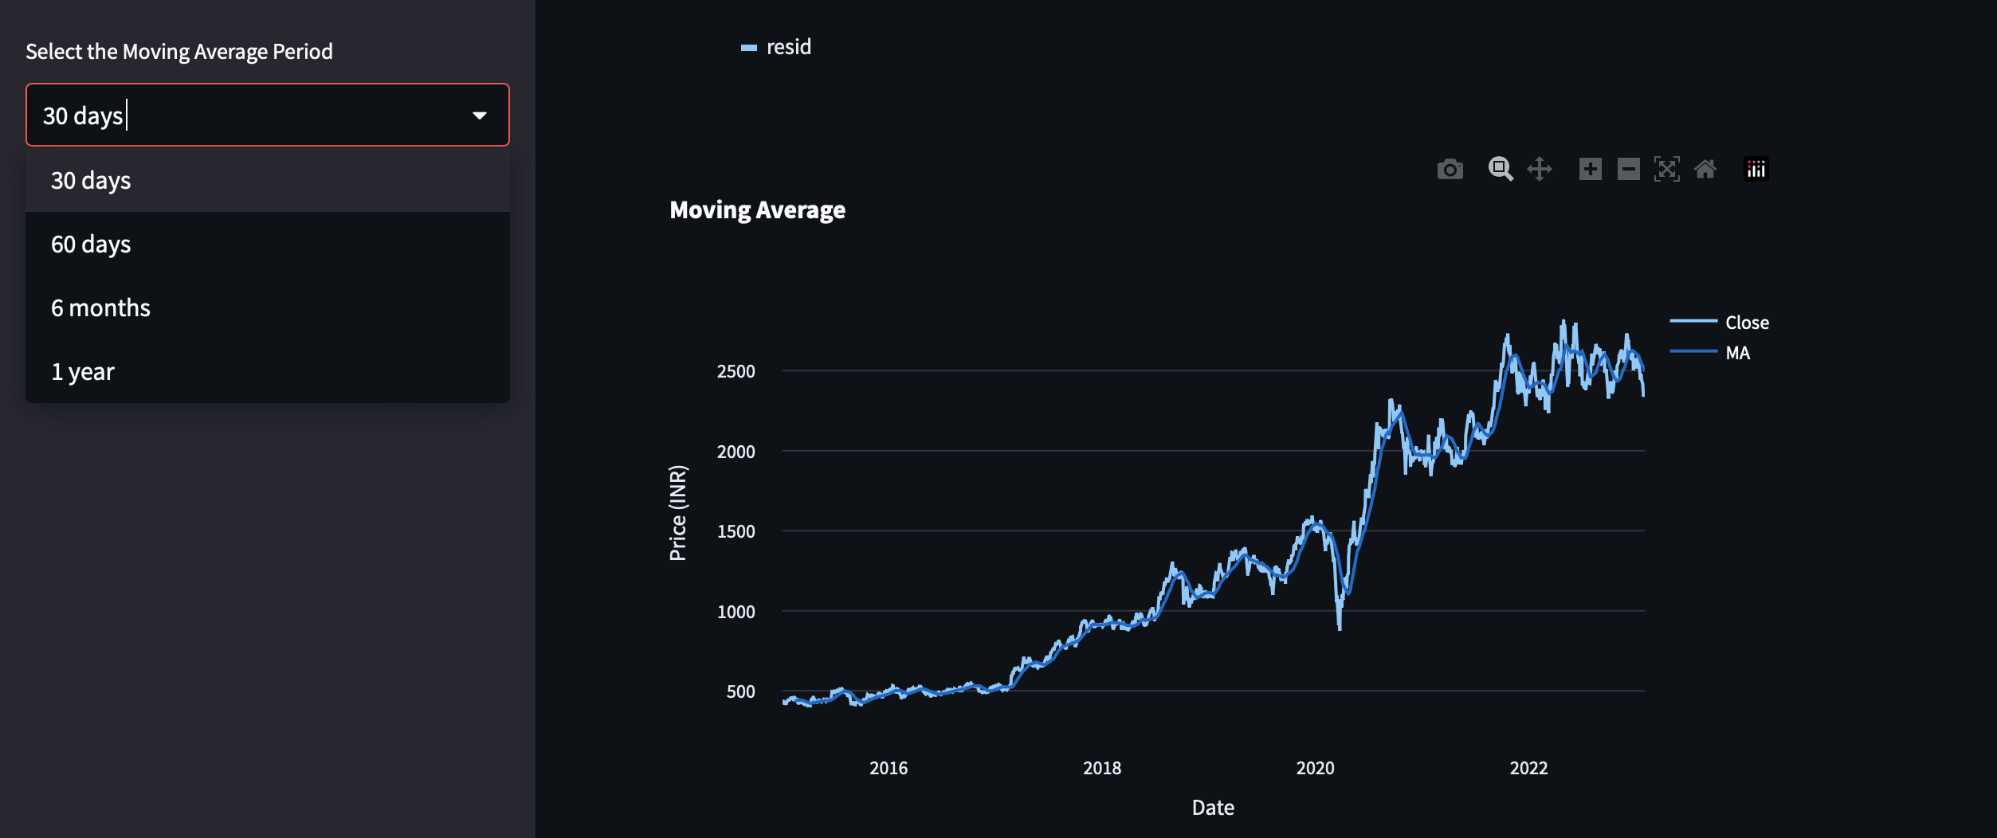
Model Deployment

Slide 16
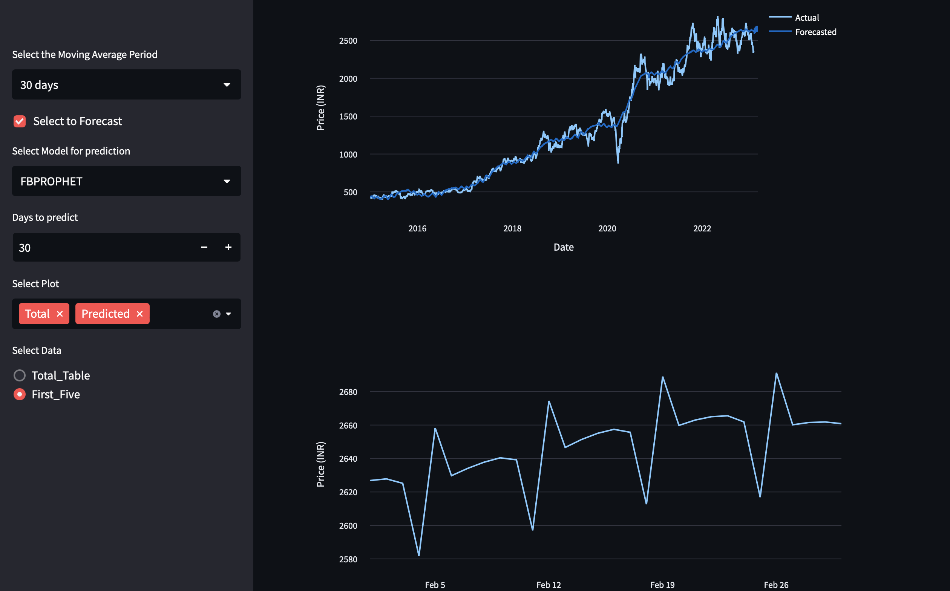
Model Deployment

Slide 17
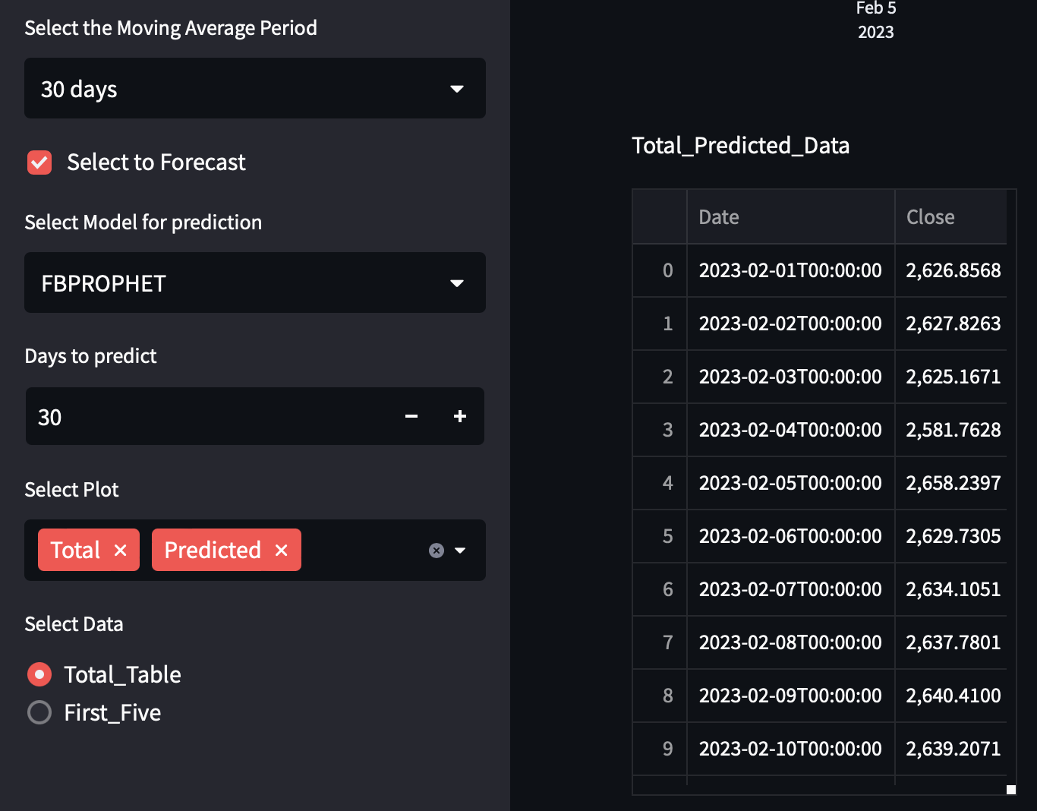
Model Deployment
These are images of the deployment and here we shown the EDA part first
In the sidebar user can select the moving average period to see various plots of moving average
To Forecast the user have to select the Forecast check box later
User can select the model ,Days to predict and whether to see the Total plot or only the predicted plot
Finally if the user wants to see the Total Predicted Values he/she can select the option of Total_table

Slide 18
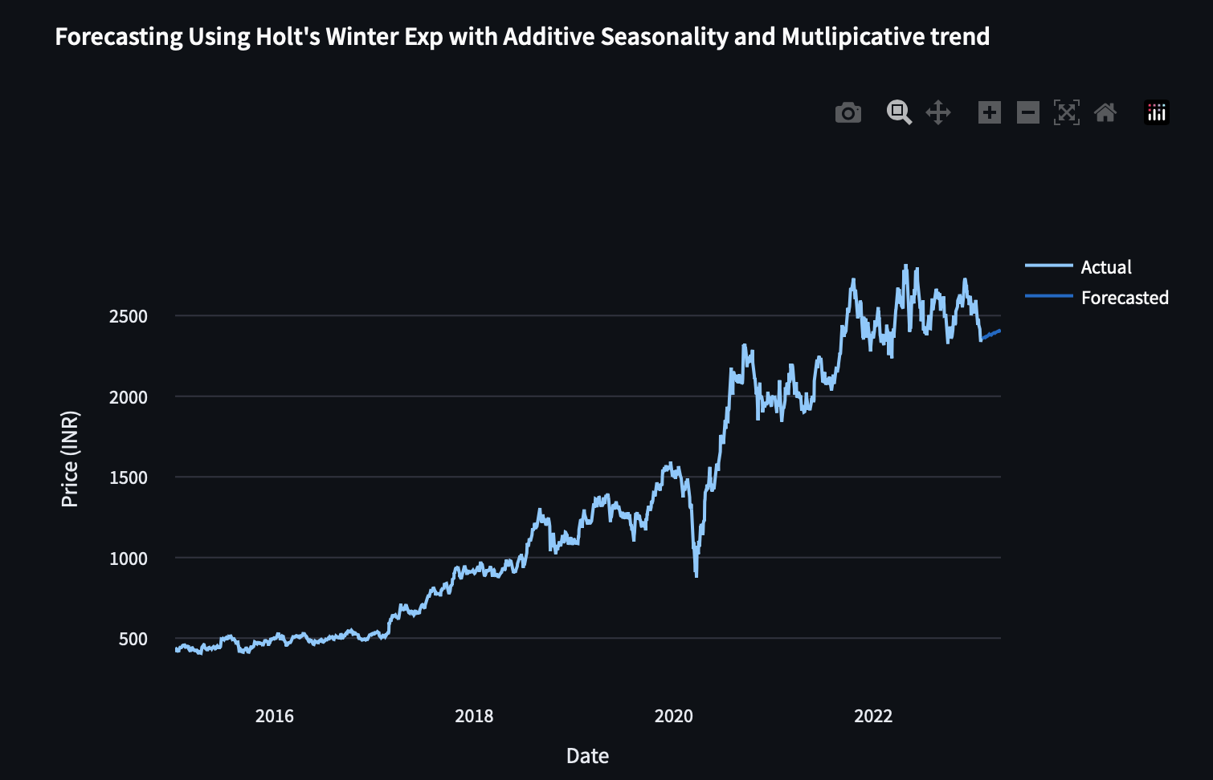
Model deployment
Plot of Actual prices vs
Predicted prices

Slide 19
THANK YOU

